Slide 1

SecureSandbox: Custom Process Isolation System
Presented by:
Muhammad Noor ul Hassan (uw-23-cy-bs-022)
Syed Ashir Nasveer (uw-23-cy-bs-009)
Muhammad Ahmed (uw-23-cy-bs-016)
Muhammad Badar Ali (uw-23-cy-bs-045)

Slide 2

What is SecureSandbox?
What is SecureSandbox?
A custom-built sandbox for executing untrusted code safely.
Runs programs in an isolated environment.
Continuously monitors behavior and resource usage Secure Execution Environment.
Why it matters
Malware analysis.
Secure testing of unknown code.
Learning OS-level security concepts.

Slide 3



Project Objectives
System Protection
Resource MonitoringWatch how much CPU, memory, threads, and network the program uses while it is running.
Prevent system damage from malicious programs
Threat Detection
Comprehensive Logging
Detect suspicious or dangerous behavior as soon as it happens.
Record everything the program does and create reports for later analysis.

Slide 4

Core Security Features
1
2
3
Process Isolation
Resource Monitoring
Activity Logging
Restricted environment variables
Isolated HOME and TEMP directories
Separate execution context
Real-time CPU usage tracking
Memory consumption measurement
Active thread counting
Complete file access records
Network connection monitoring
Security violation documentation

Slide 5
Security Enforcement Mechanisms
Implemented Controls
Real-Time Response
Process TerminationAllows the user or the system to stop a program if it behaves suspiciously.
Sandbox continuously logs all security violations and immediately blocks unauthorized access attempts, providing immediate feedback on potentially malicious behavior.
Behavior DetectionDetects unusual actions that may indicate malicious or unauthorized activity.
Privilege RestrictionEnsures programs run with limited permissions and cannot gain higher system access.

Slide 6
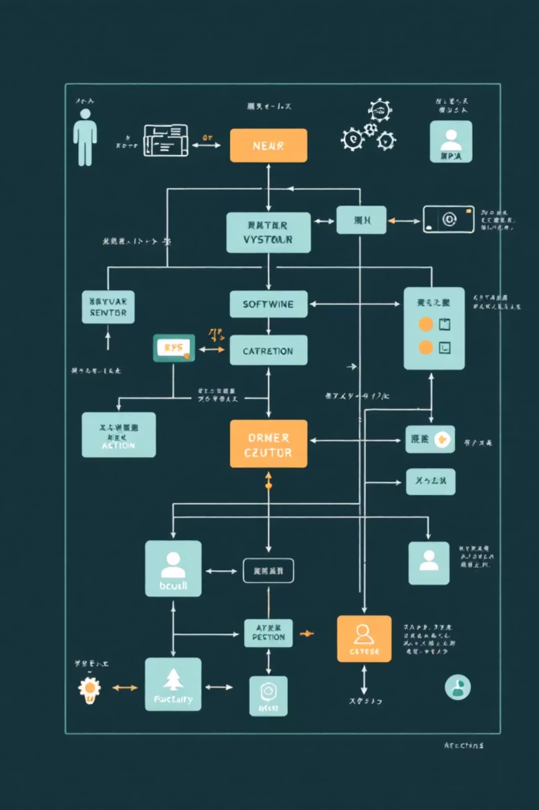




Technical Architecture
Tkinter GUI
User-friendly interface for launching and monitoring sandboxed programs
SandboxCore Engine
Central processing module handling isolation and security enforcement
Subprocess Execution
Launches programs in restricted environment with limited permissions
psutil Monitoring
Collects real-time resource usage statistics and behavioral data

Slide 7

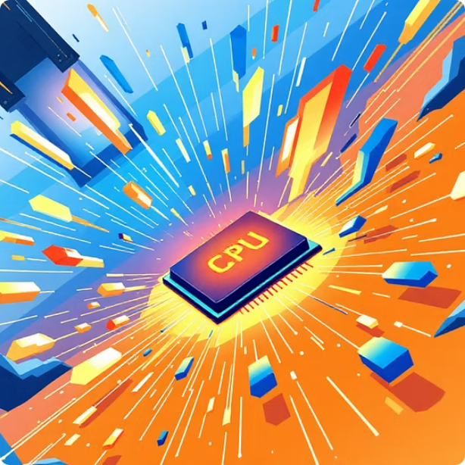



Test Programs & Validation
test_normal.py
test_resources.py
test_file_access.py
test_network.py
Standard program execution validating basic sandbox functionality and normal behavior tracking
CPU and memory stress testing to evaluate resource monitoring and throttling capabilities
File system access attempts testing directory blocking and file operation logging
Network activity simulation for monitoring connection attempts and traffic analysis
test_suspicious.py
Malicious behavior simulation testing security violation detection and automatic response

Slide 8
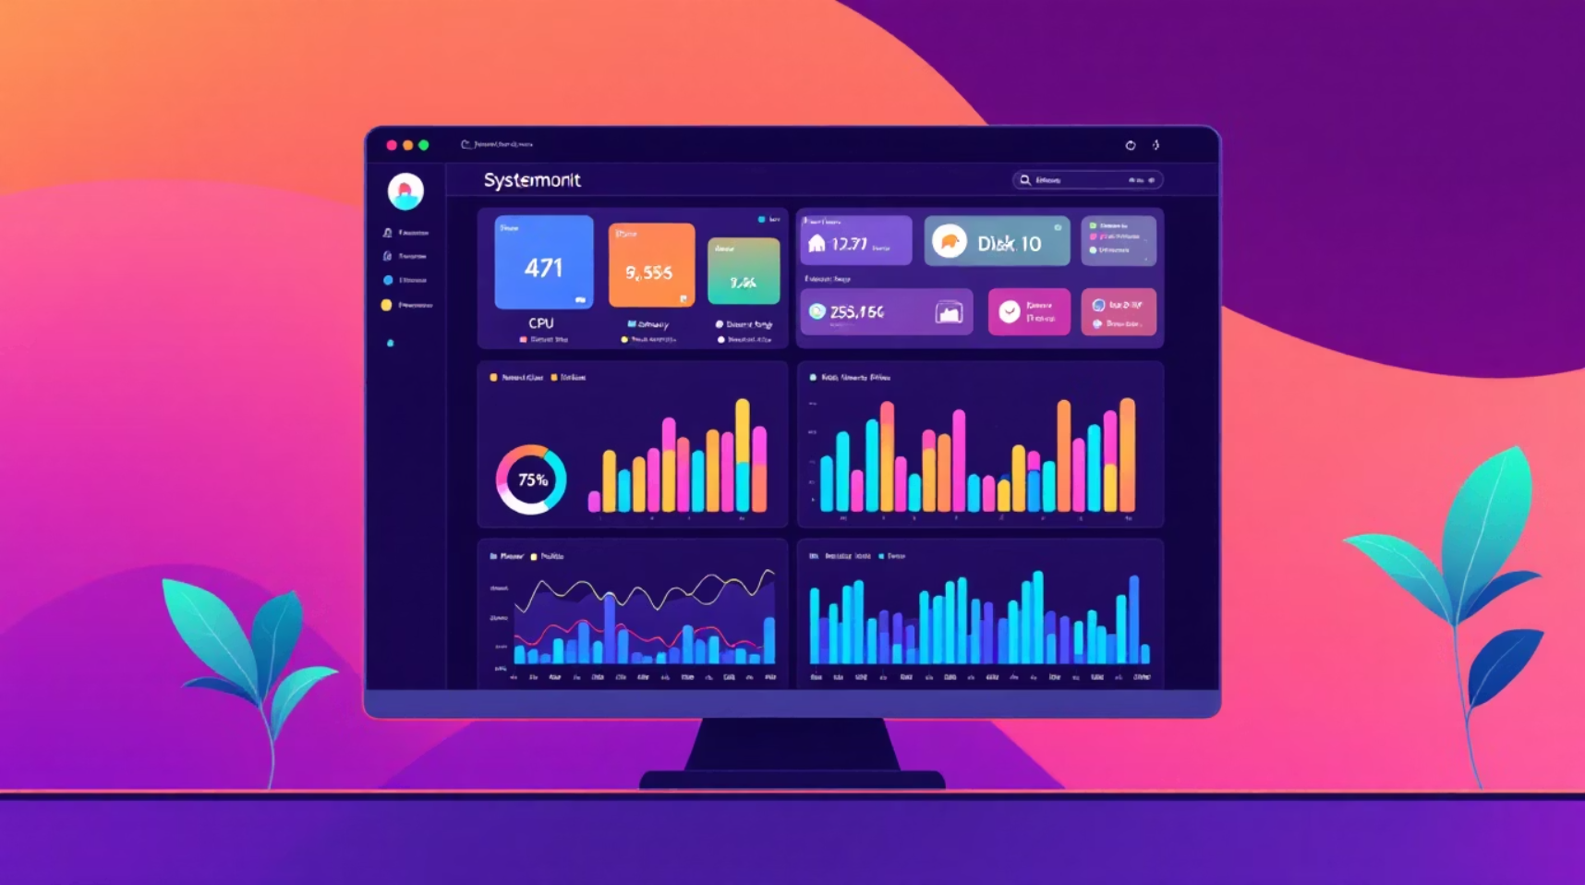

Monitoring Capabilities
Real-Time Tracking
CPU Usage Percentage
Processor load monitoring updated every second
Memory Consumption
RAM usage tracked in megabytes with allocation patterns
Active Thread Count
Number of concurrent execution threads maintained
Network Connections
Active TCP/UDP connections and ports monitored
Open File Handles
Data collection occurs every second, providing granular visibility into program behavior throughout execution
File system access points and read/write operations

Slide 9
Reporting & Current Limitations
JSON Execution Report
Creates a structured report that shows how the program ran, its resource usage, and any security issues.
Activity TimelineKeeps a time-based record of everything the program did, making it easy to follow its actions step by step.
Security Violation SummaryProvides a short summary of all detected threats, blocked actions, and suspicious behavior.
Important Limitations
Userspace-level isolation only, not kernel-level protection
Not enterprise-grade security solution
Cannot prevent advanced zero-day exploits
Intended for educational purposes, not production malware analysis

Slide 10
Conclusion & Future Enhancements
Key Learnings
Process isolation and permission control
OS security and access control concepts
CPU and memory resource monitoring
Detection of suspicious program behavior
Future Enhancements
Docker or VM-based isolation
System call tracing
Network packet analysis
Machine learning–based threat detection

